Slide 1




(21CC505PC) SOFTWARE ENGINEERING LAB
UPPAL CAMPUS
NARAYANGUDA
IBRAHIMPATNAM
LAB EXERCISE - 5
BUILD TOOLS
TOPIC -2
CREATING MAVEN JAVA PROJECT USING ECLIPSE AND PUSH INTO TO GITHUB
BY
B MADHURIKA(Ph.D.)
Assistant Professor
CSE

Slide 2

SOFTWARE ENGINEERING LAB
(21CC505PC)
BY
MADHURIKA BUDARAJU(Ph.D.)
ASSISTANT PROFESSOR
CSE
KMIT

Slide 3
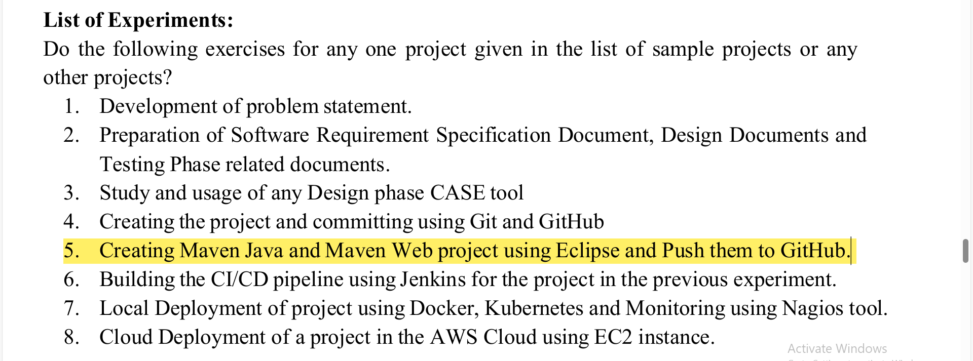

Slide 4
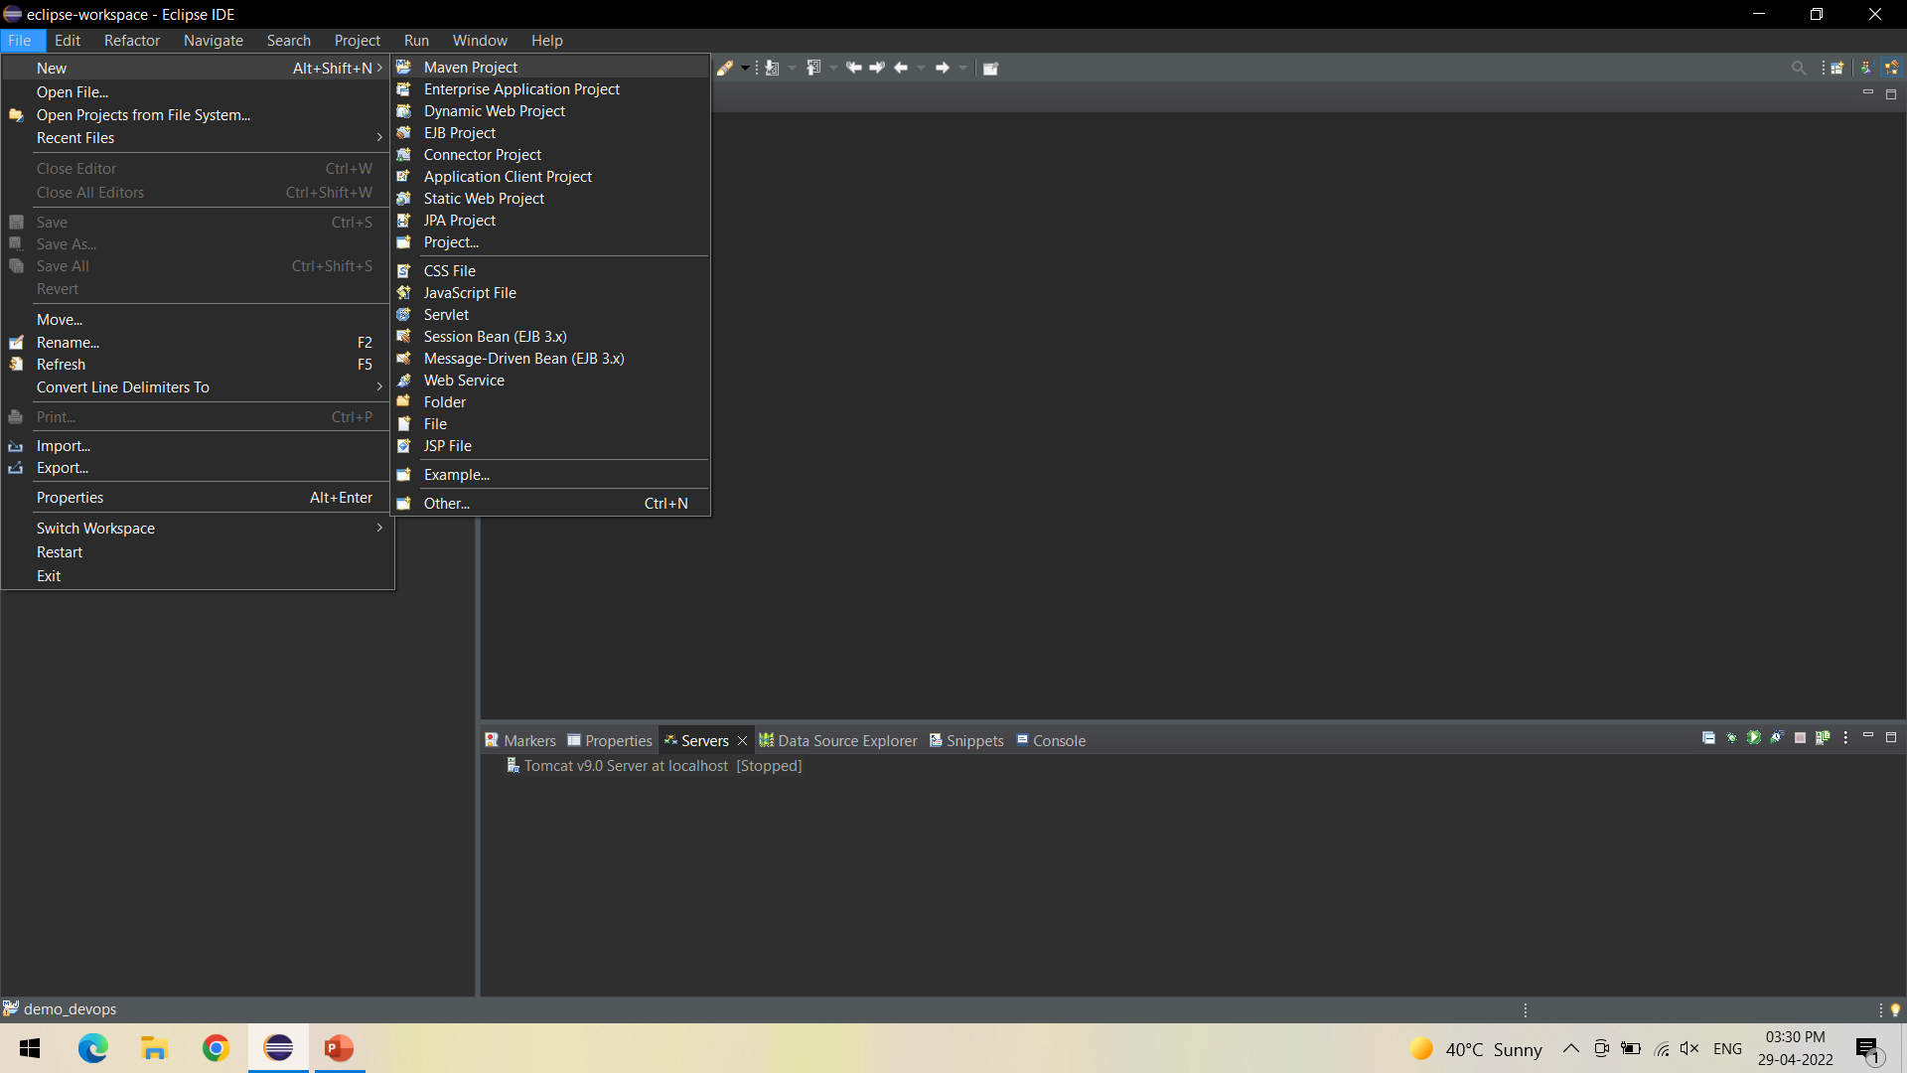
Create a Maven Project - > File - > New -> Maven Project

Slide 5
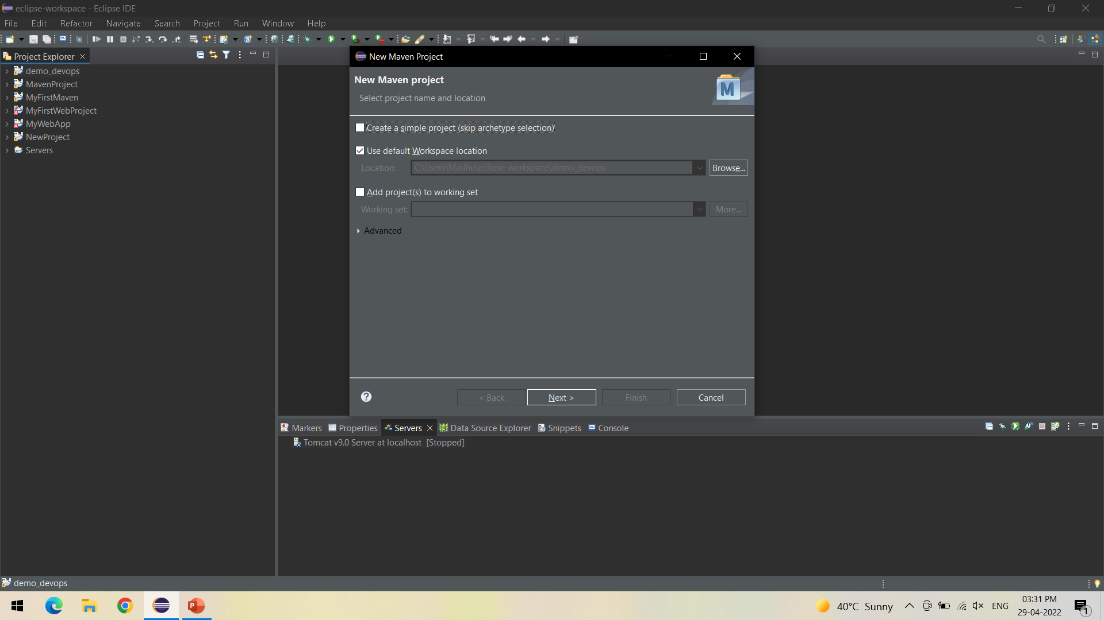
Click on Next

Slide 6
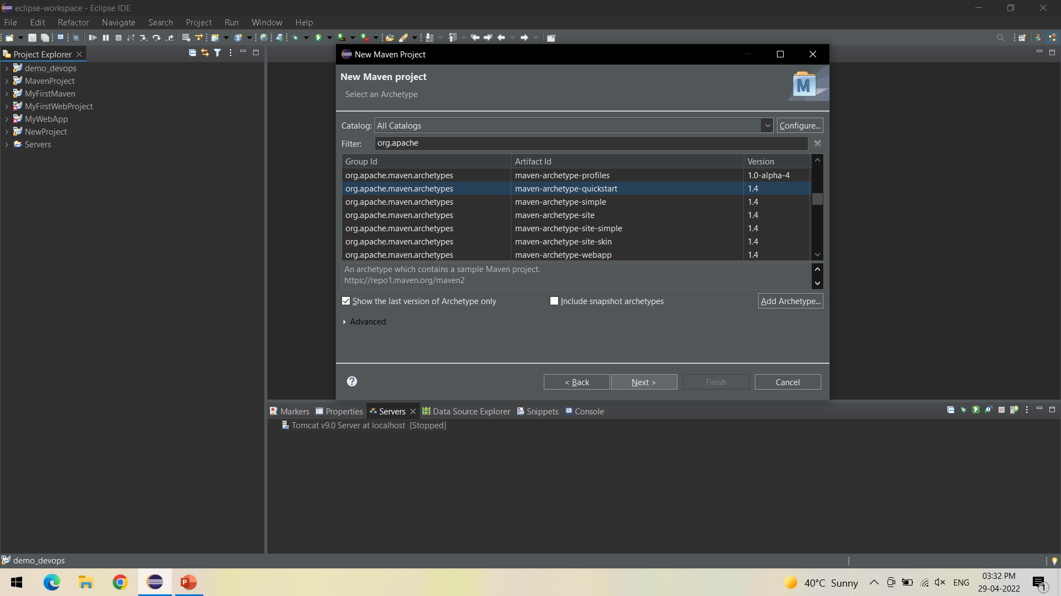
Select the quickstart archetype under org.apache.maven.archetypes and click on Next

Slide 7
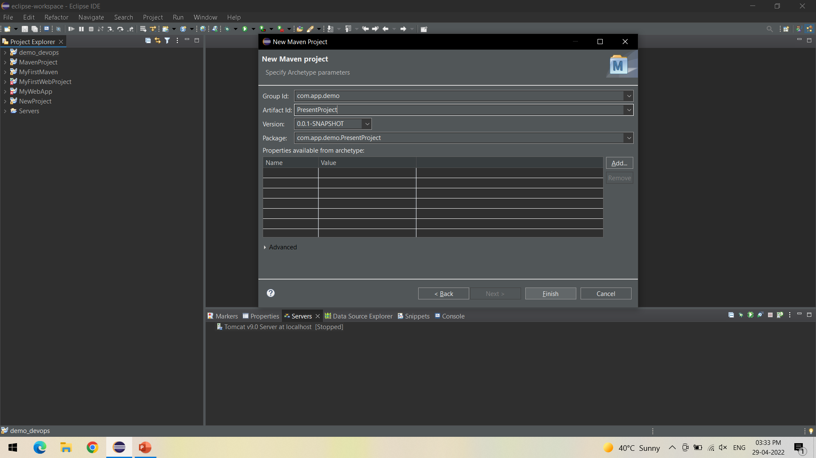
Give Artifact ID of your choice and click Finish, Maven Project is created

Slide 8
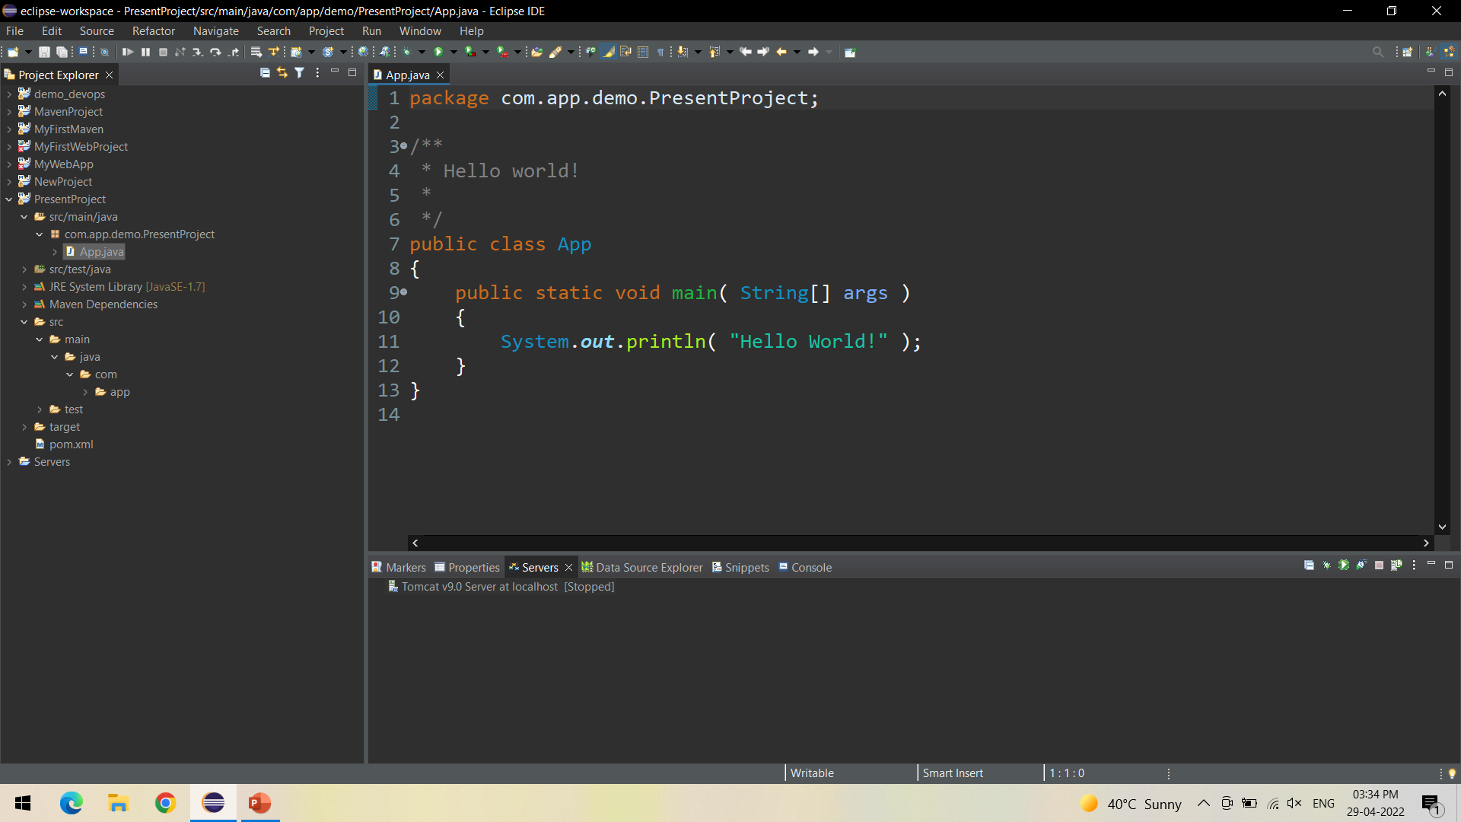
In the created project, Check for App.java file containing Hello World program

Slide 9
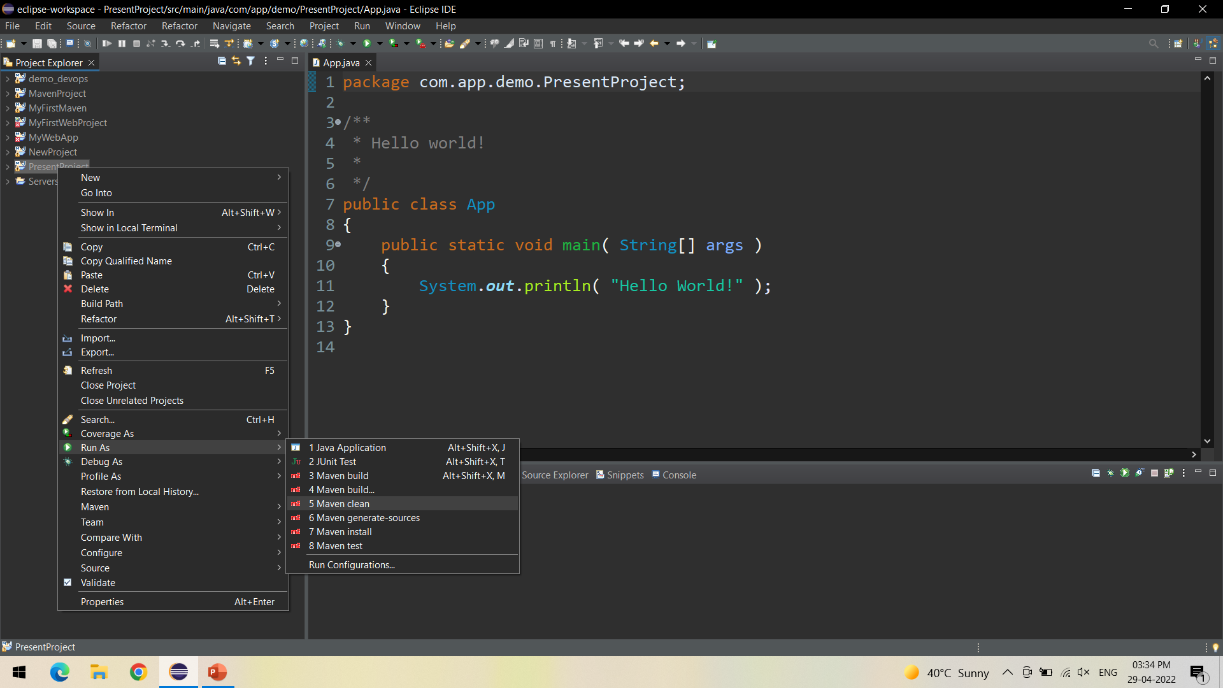
Right click on your project and Run As Maven Clean - It clears out the existing classes that you compiled from last compile

Slide 10
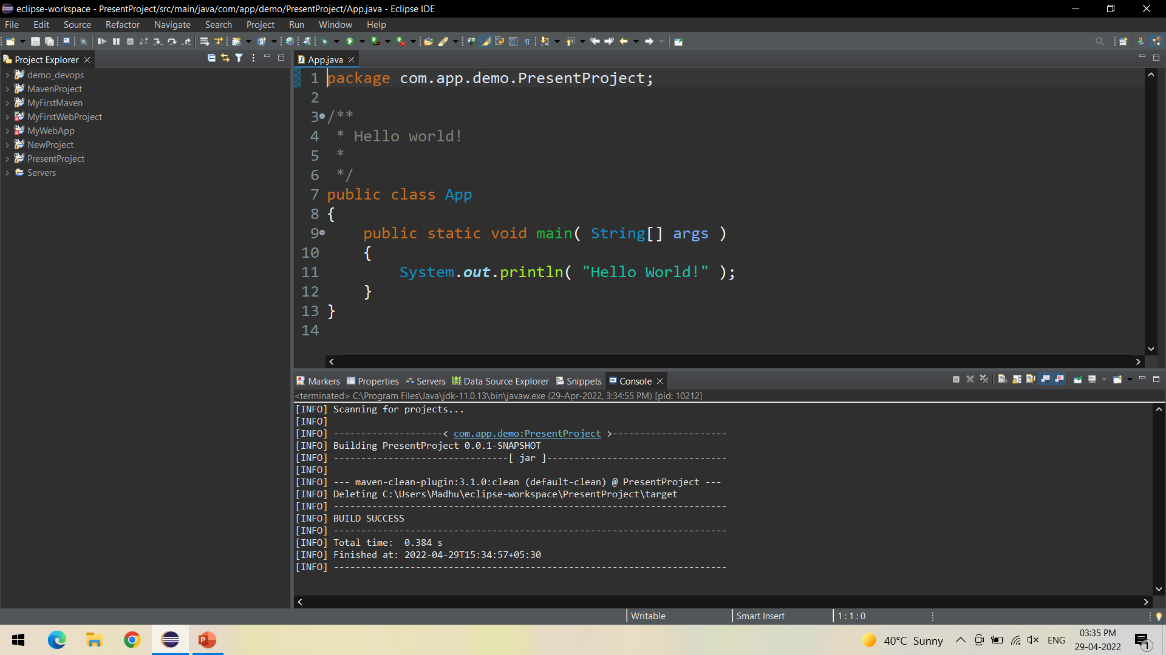
Check the console for Build Success

Slide 11
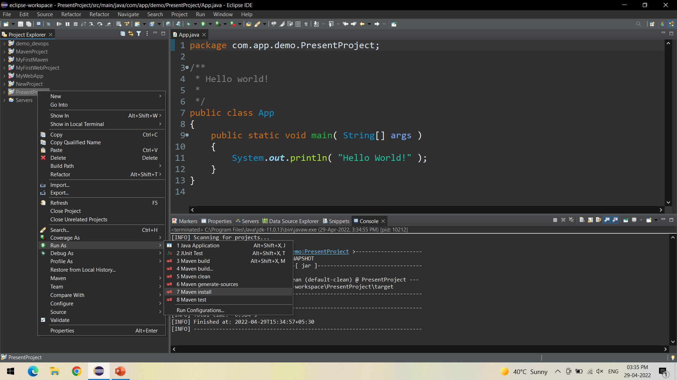
Right click on your project and Run As Maven Install - to add artifact(s) to the local repository

Slide 12
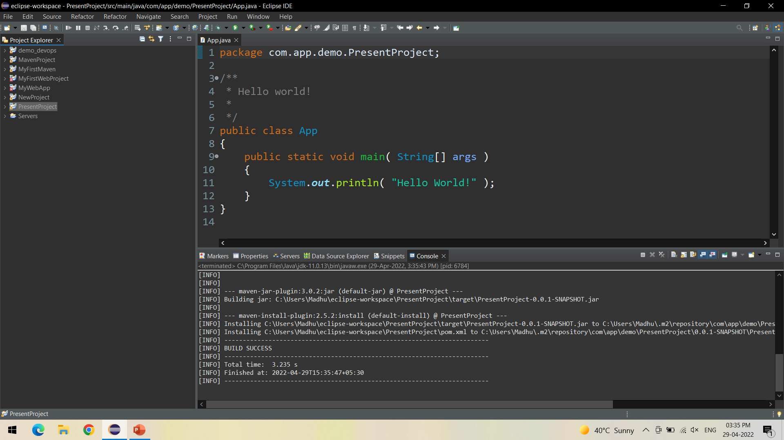
Check the console for Build Success

Slide 13
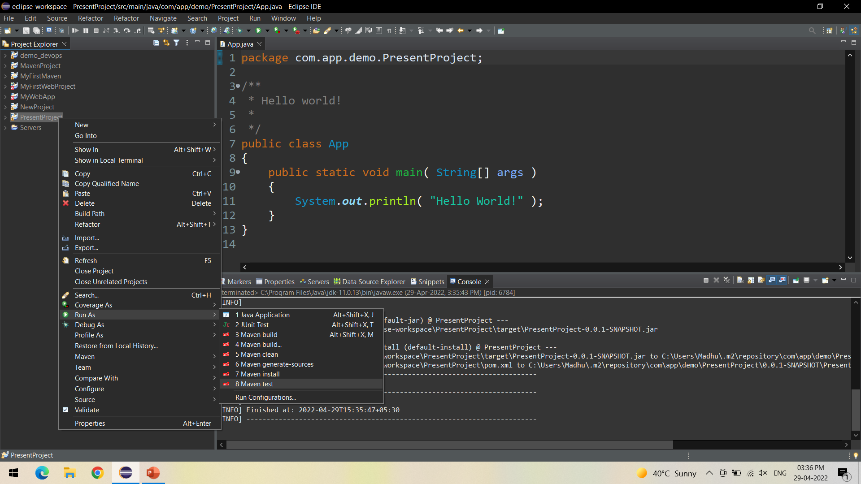
Right click on your project and Run As Maven Install - use to specify test classes or methods we want to execute

Slide 14
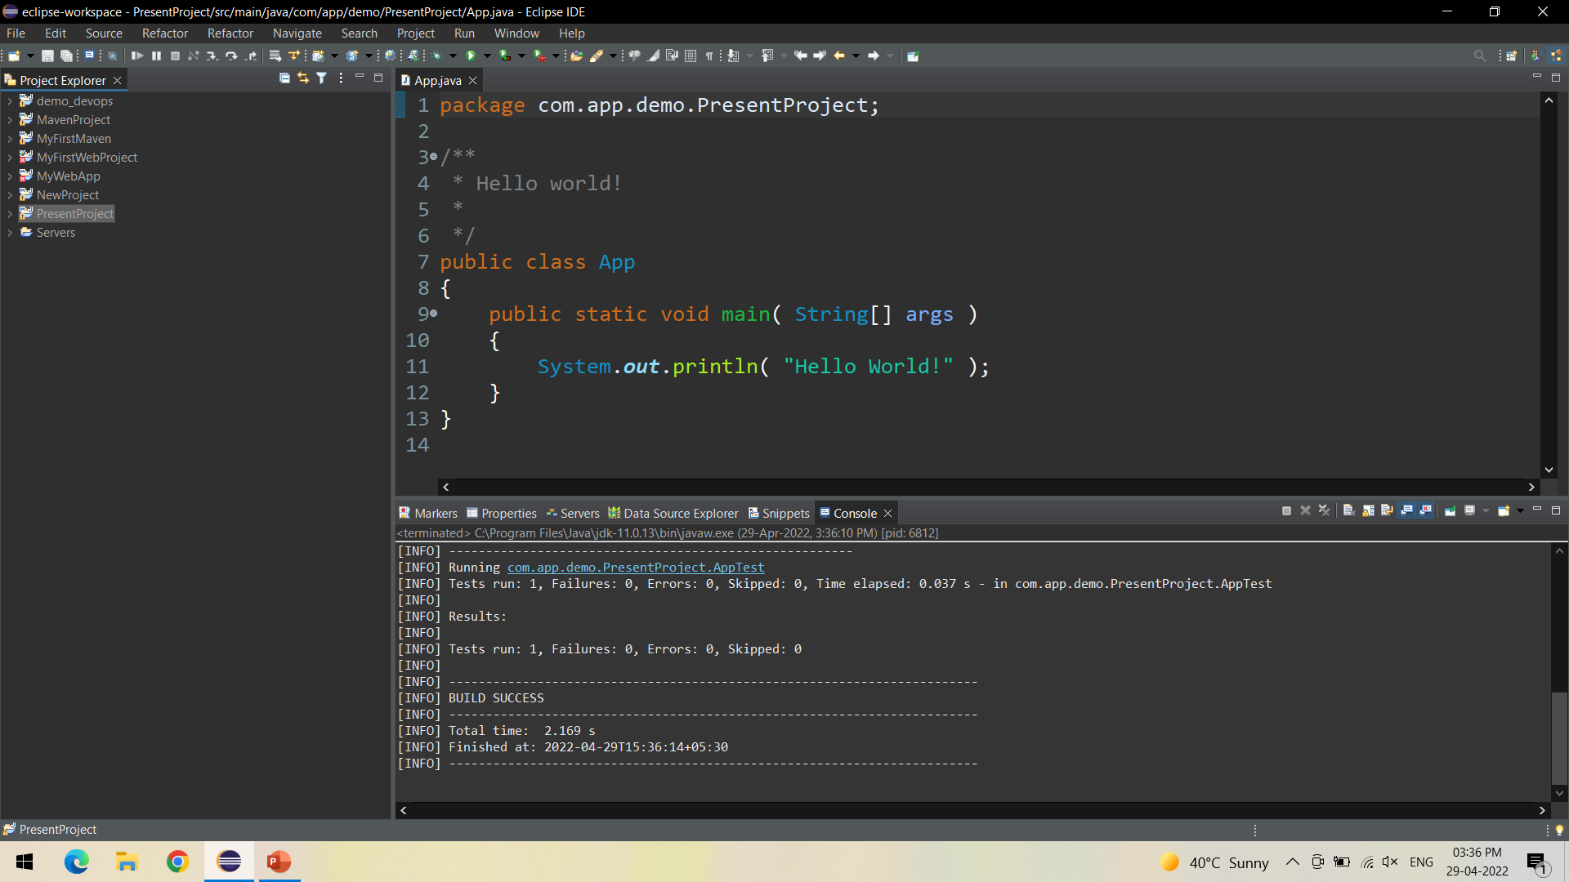
Check the console for Build Success

Slide 15
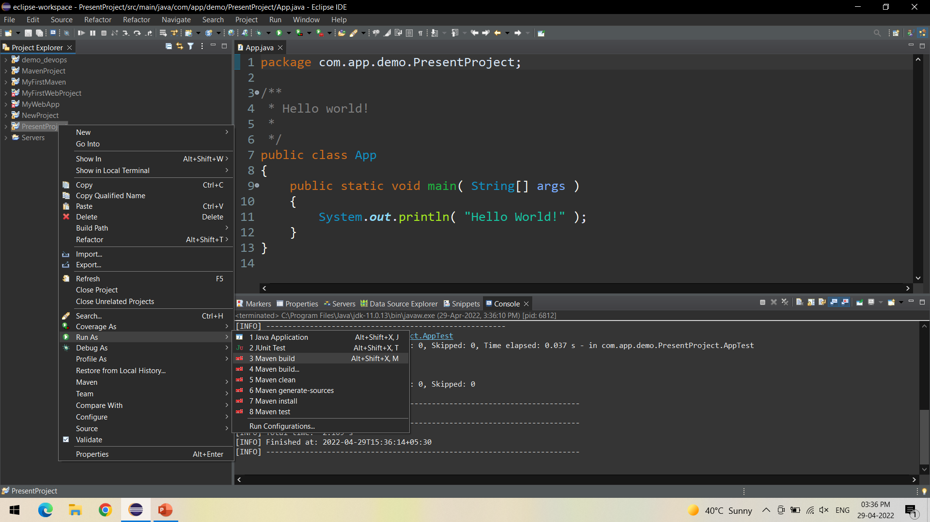
Right click on your project and Run As Maven Install - Compiles source code of the project, Creates JAR or WAR file for the project to convert it into a distributable format.

Slide 16
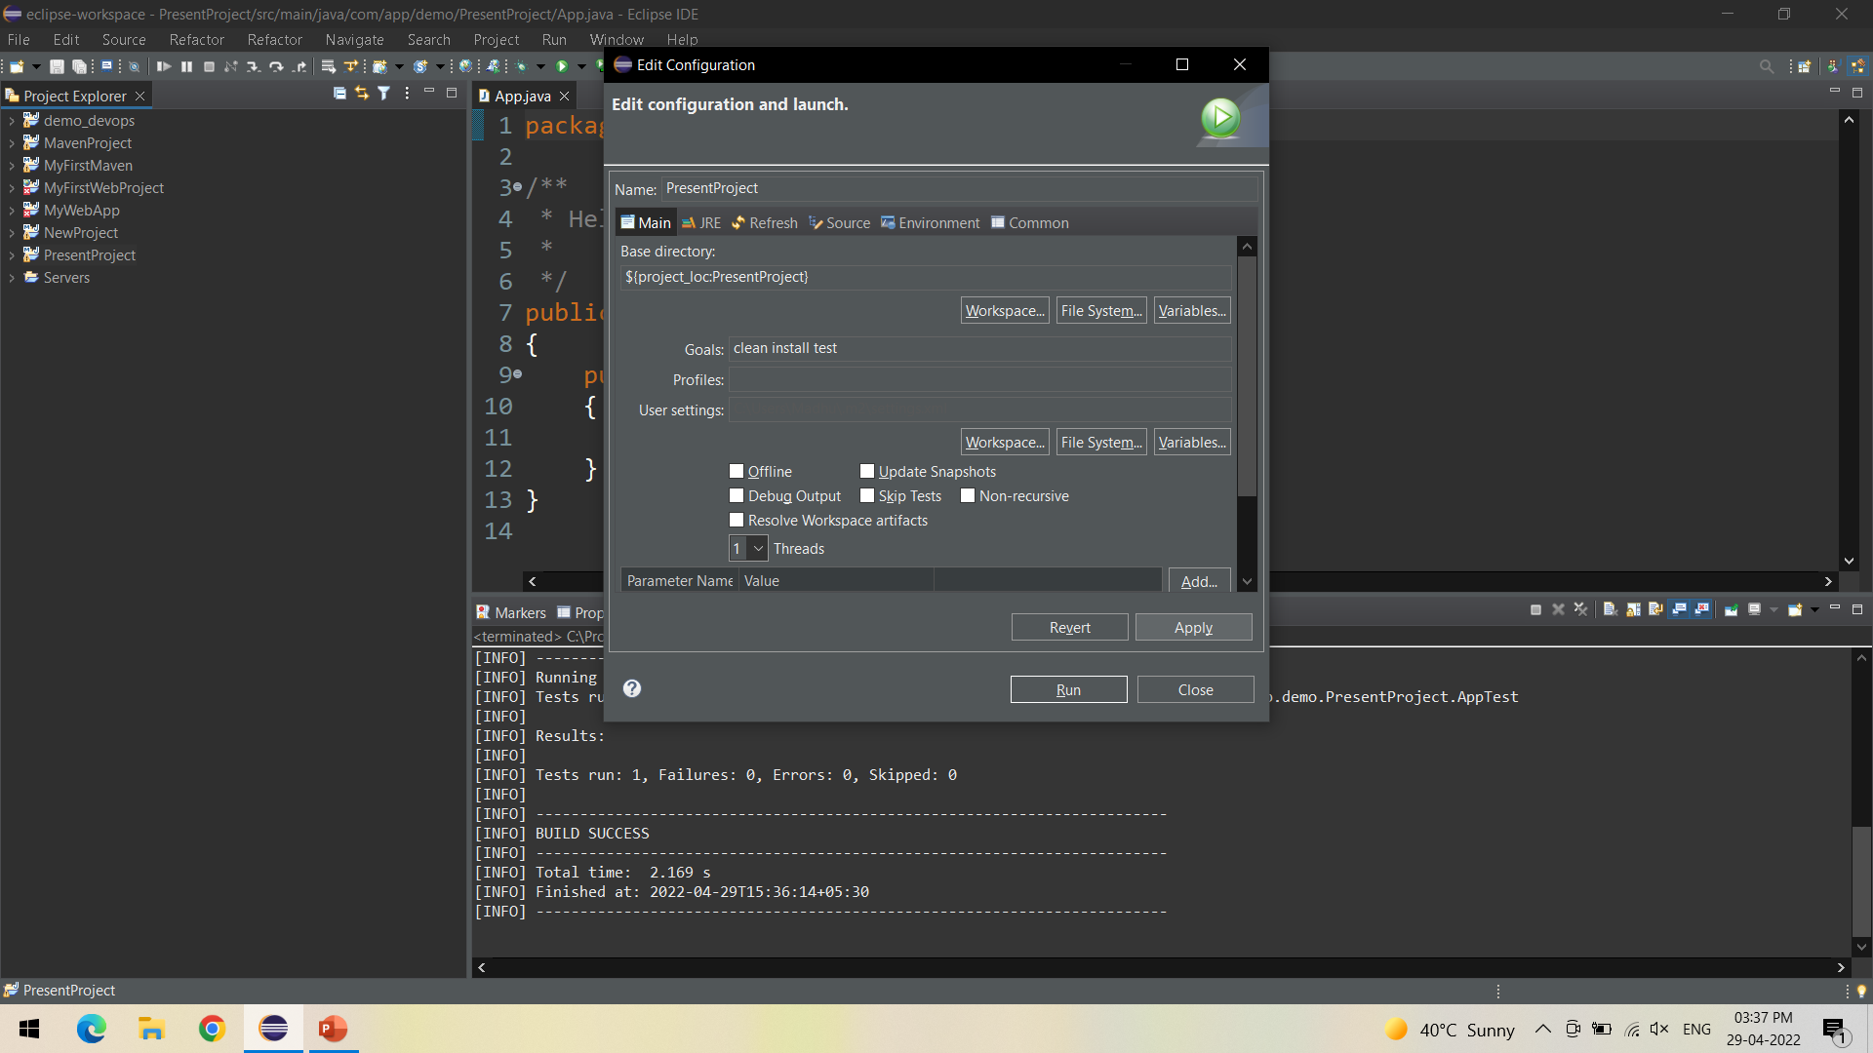
Specify the goals as – Clean Install Test -> Click on Apply

Slide 17

Click on Run

Slide 18
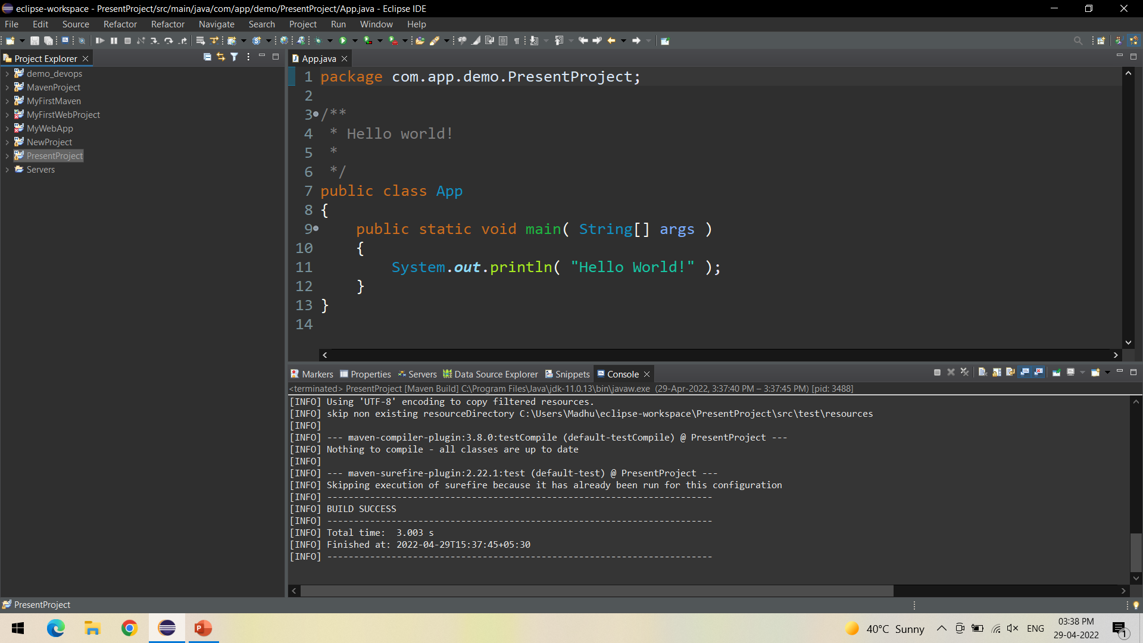
Check for Build Success in Console

Slide 19
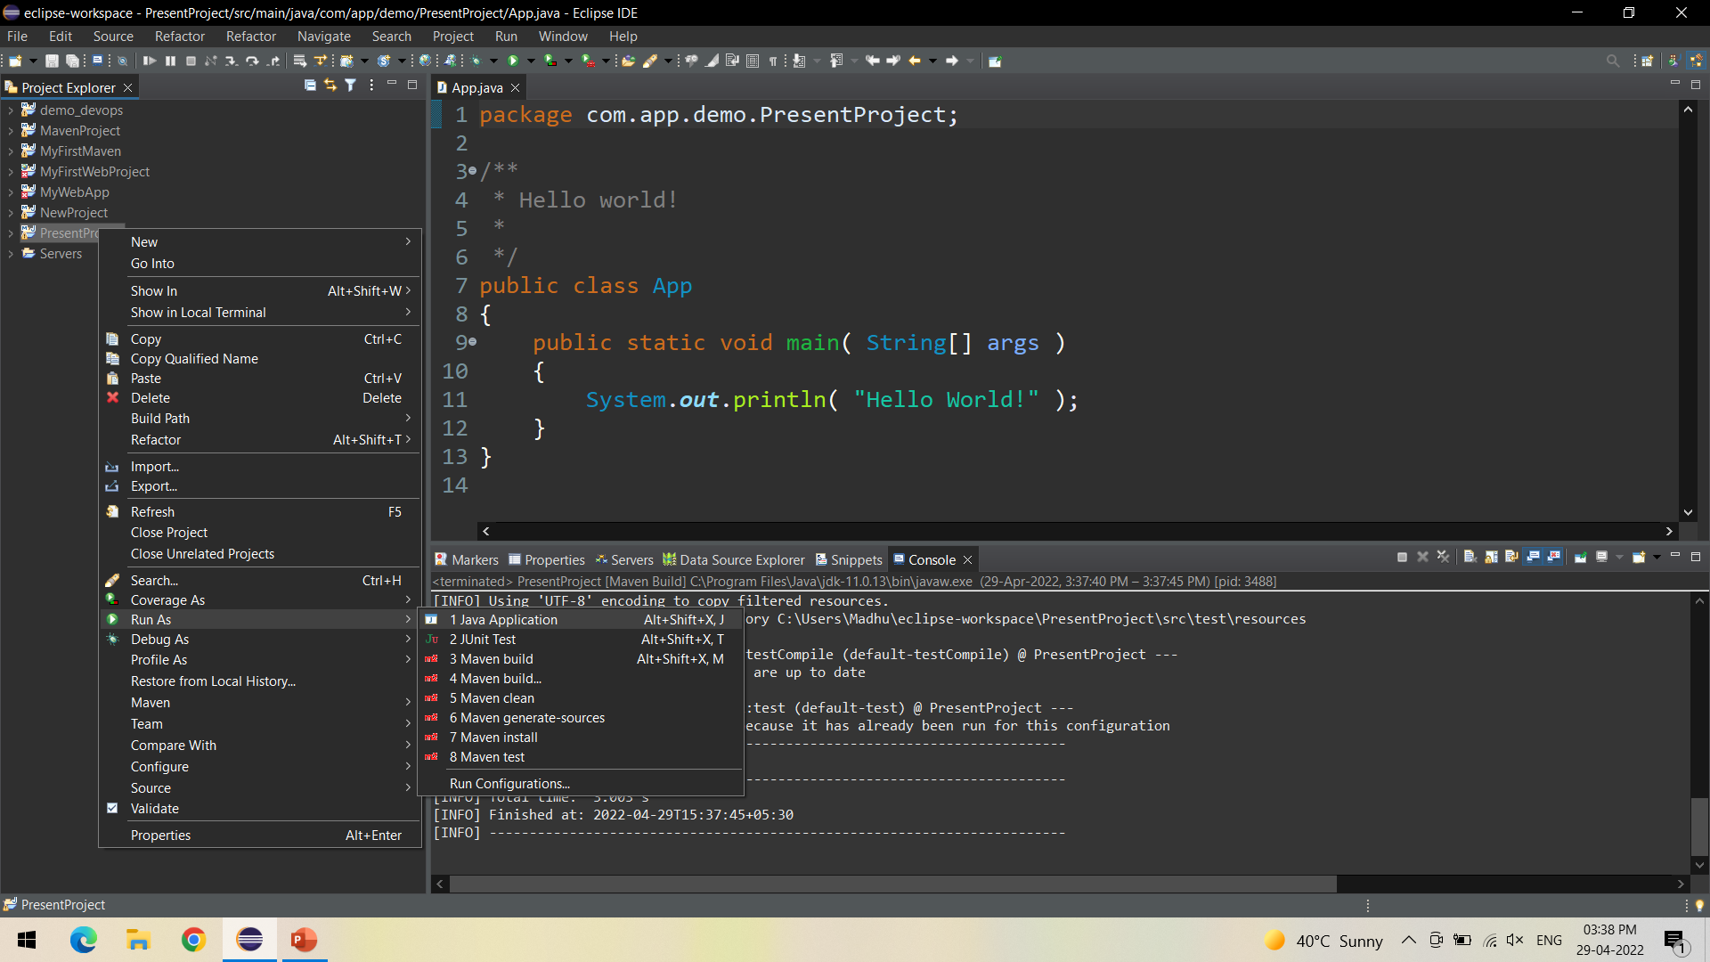
Now Run the Project as Java Application to test the output

Slide 20
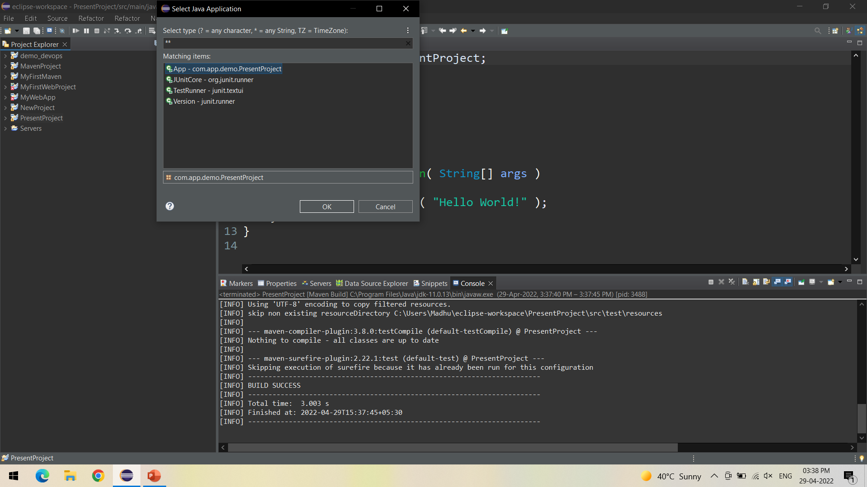
Select the Created project from the list - > Click Ok

Slide 21
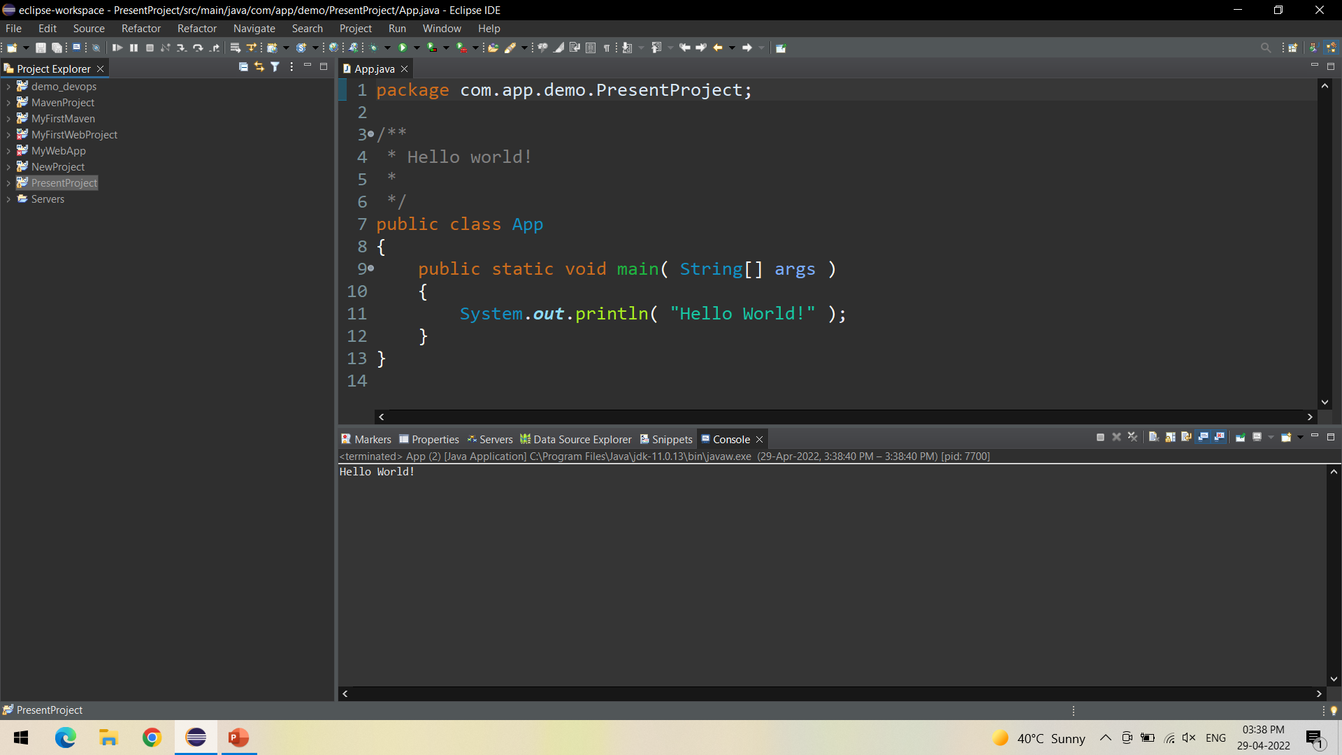
In the console we can view the output of the project

Slide 22
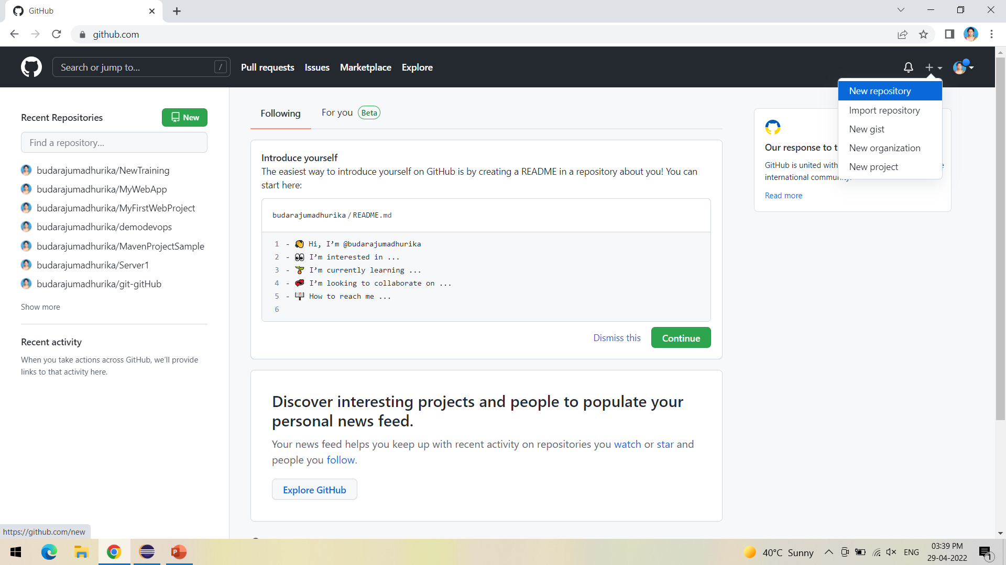
Next is to push the project into GitHub, for this, create a new repository in GitHub

Slide 23
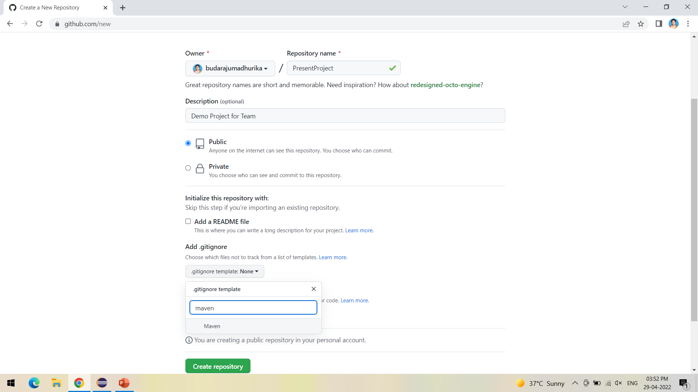
Select Maven in gitignore- to ignore unwanted target files in maven project while committing

Slide 24
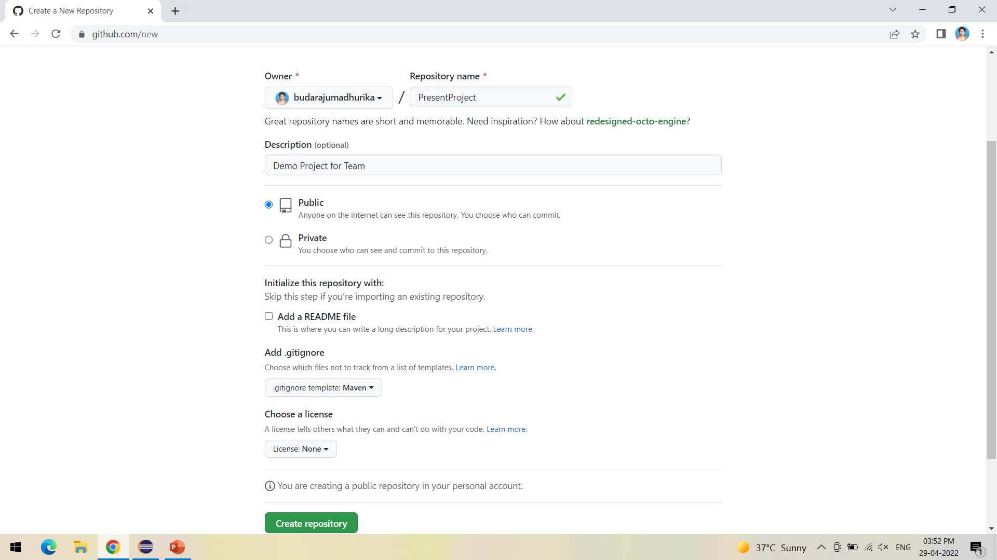
Click on create repository

Slide 25
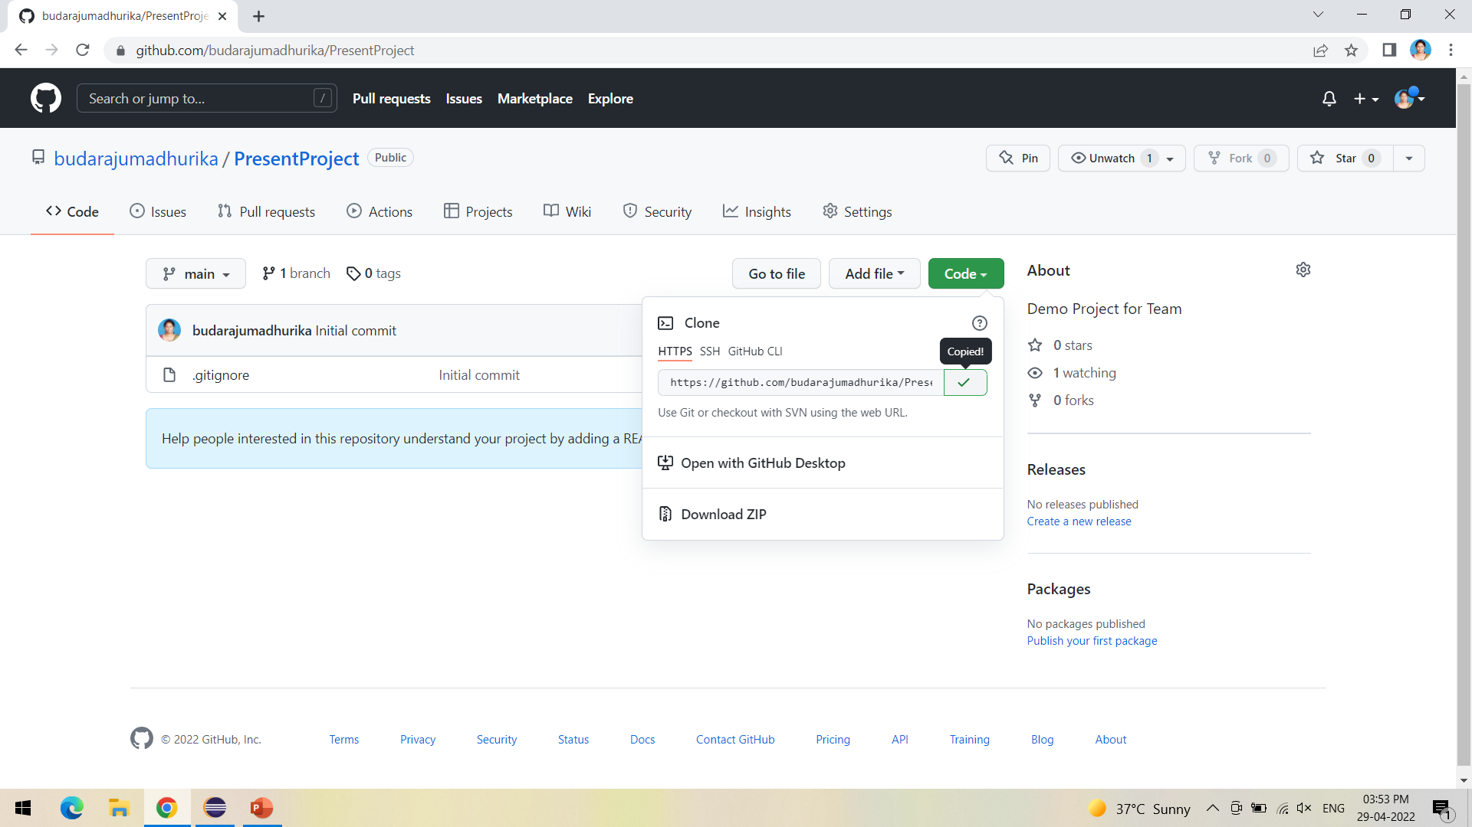
Copy the HTTPs URL as shown to be copied into Jenkins

Slide 26
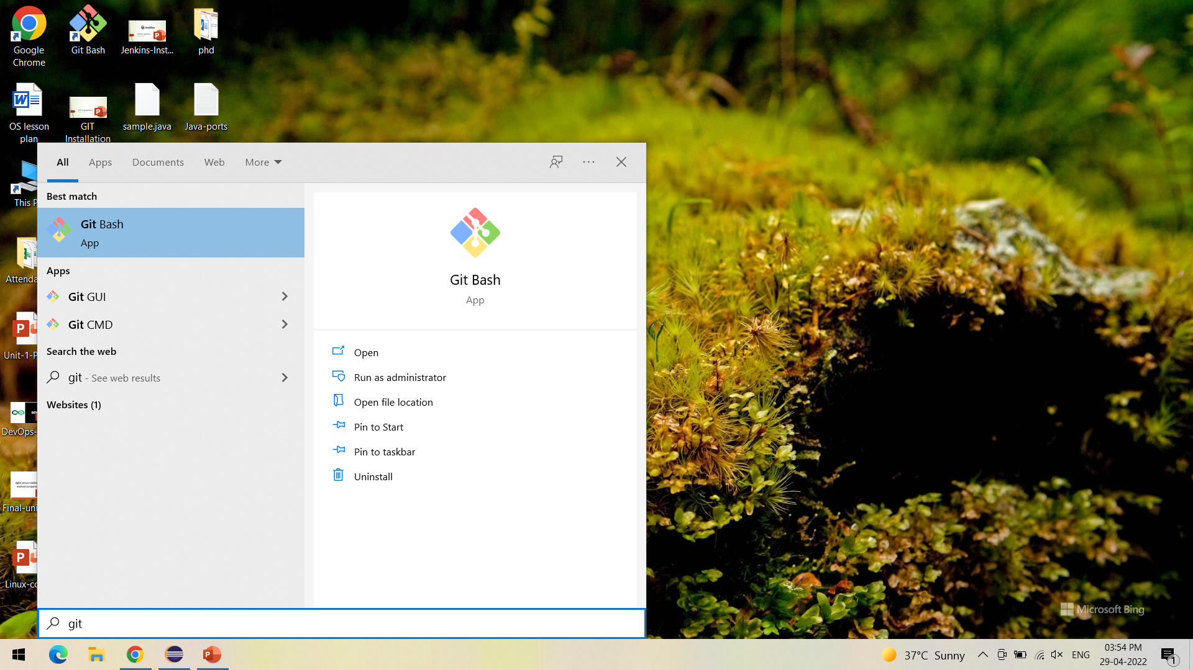
Open Git Bash to push the project into GitHub

Slide 27
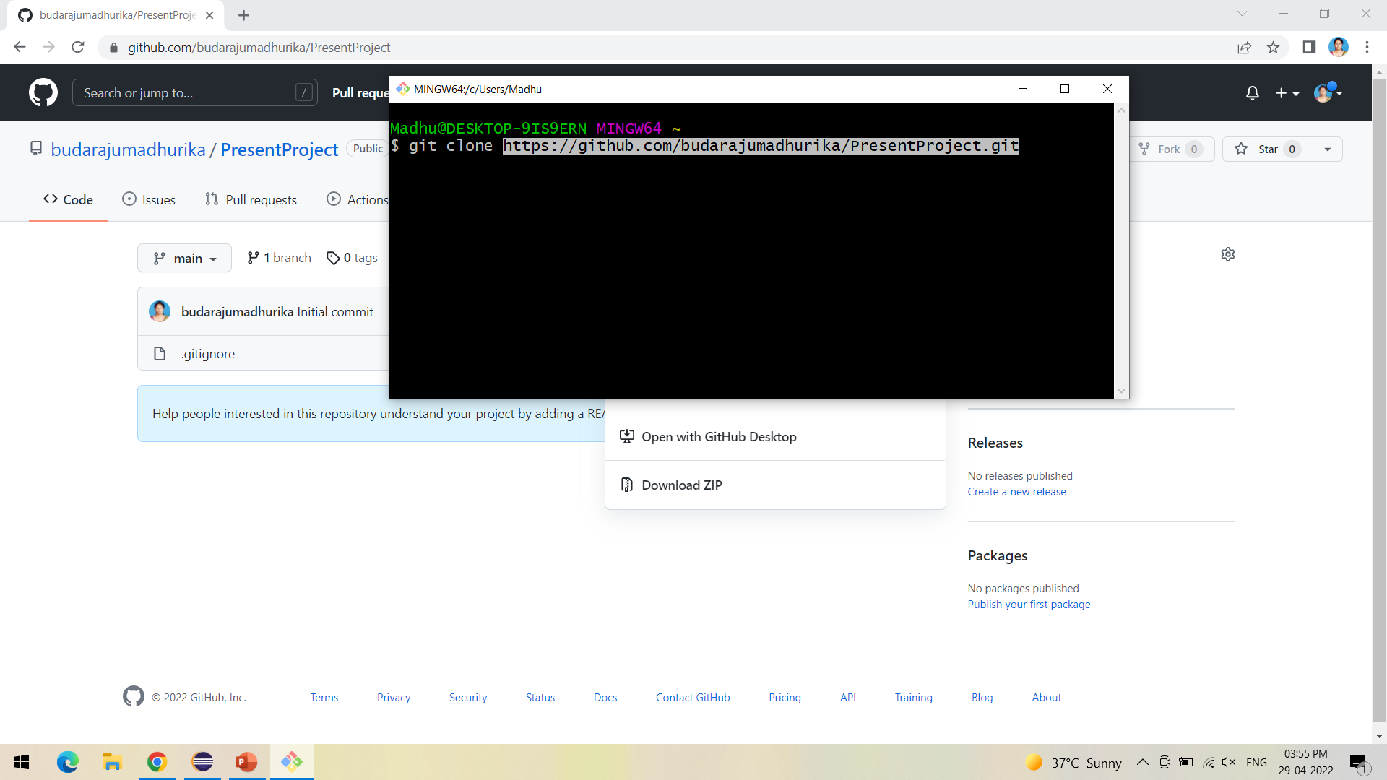
Clone the GitHub repository into the local system

Slide 28
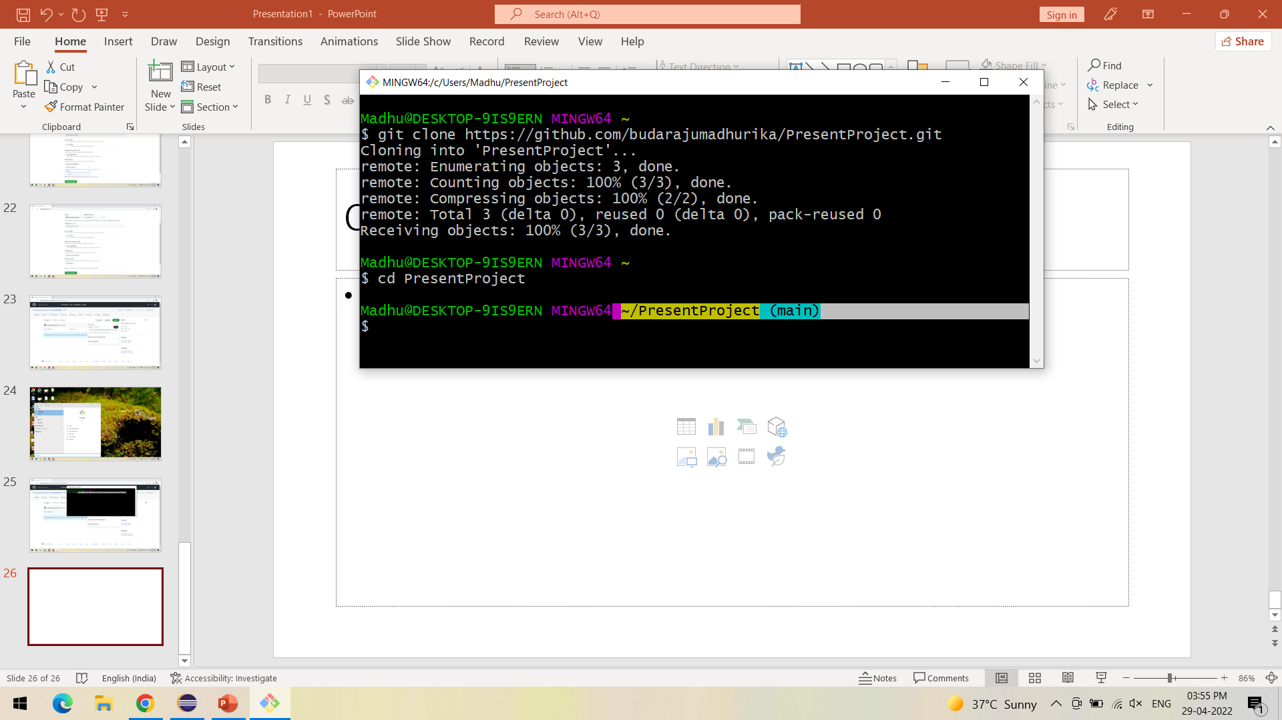
After cloning follow the steps as shown

Slide 29
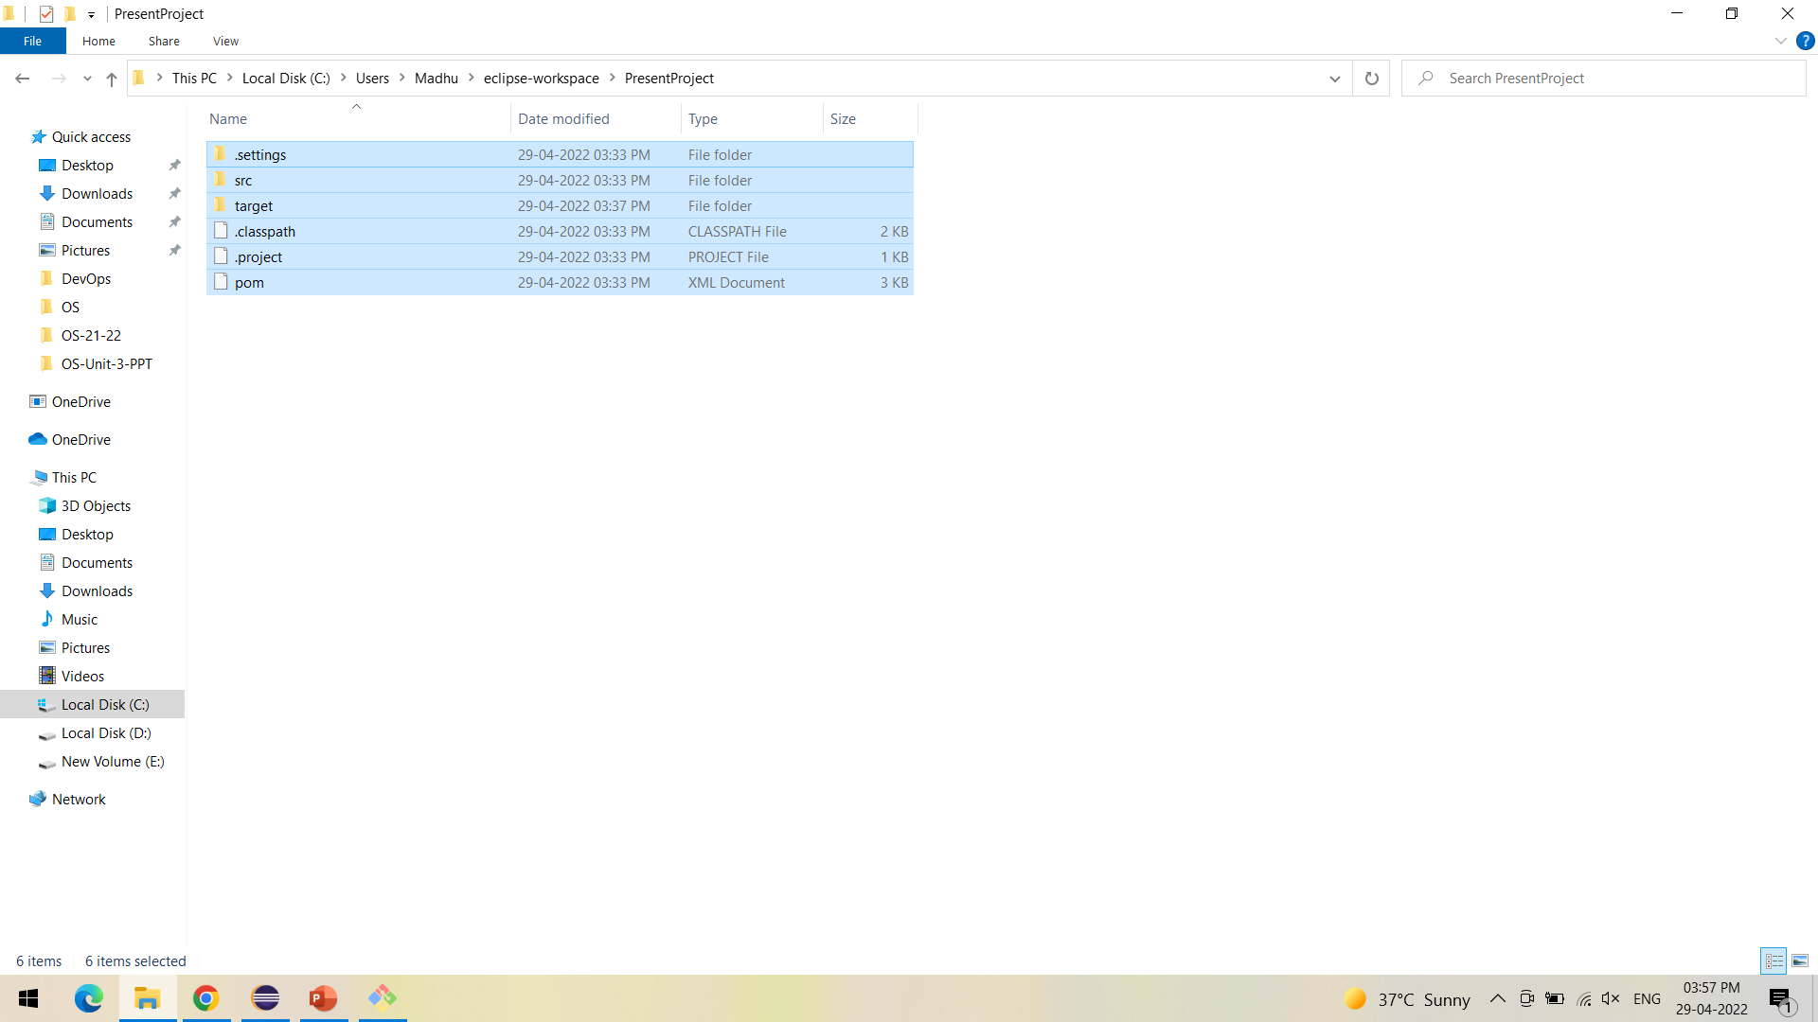
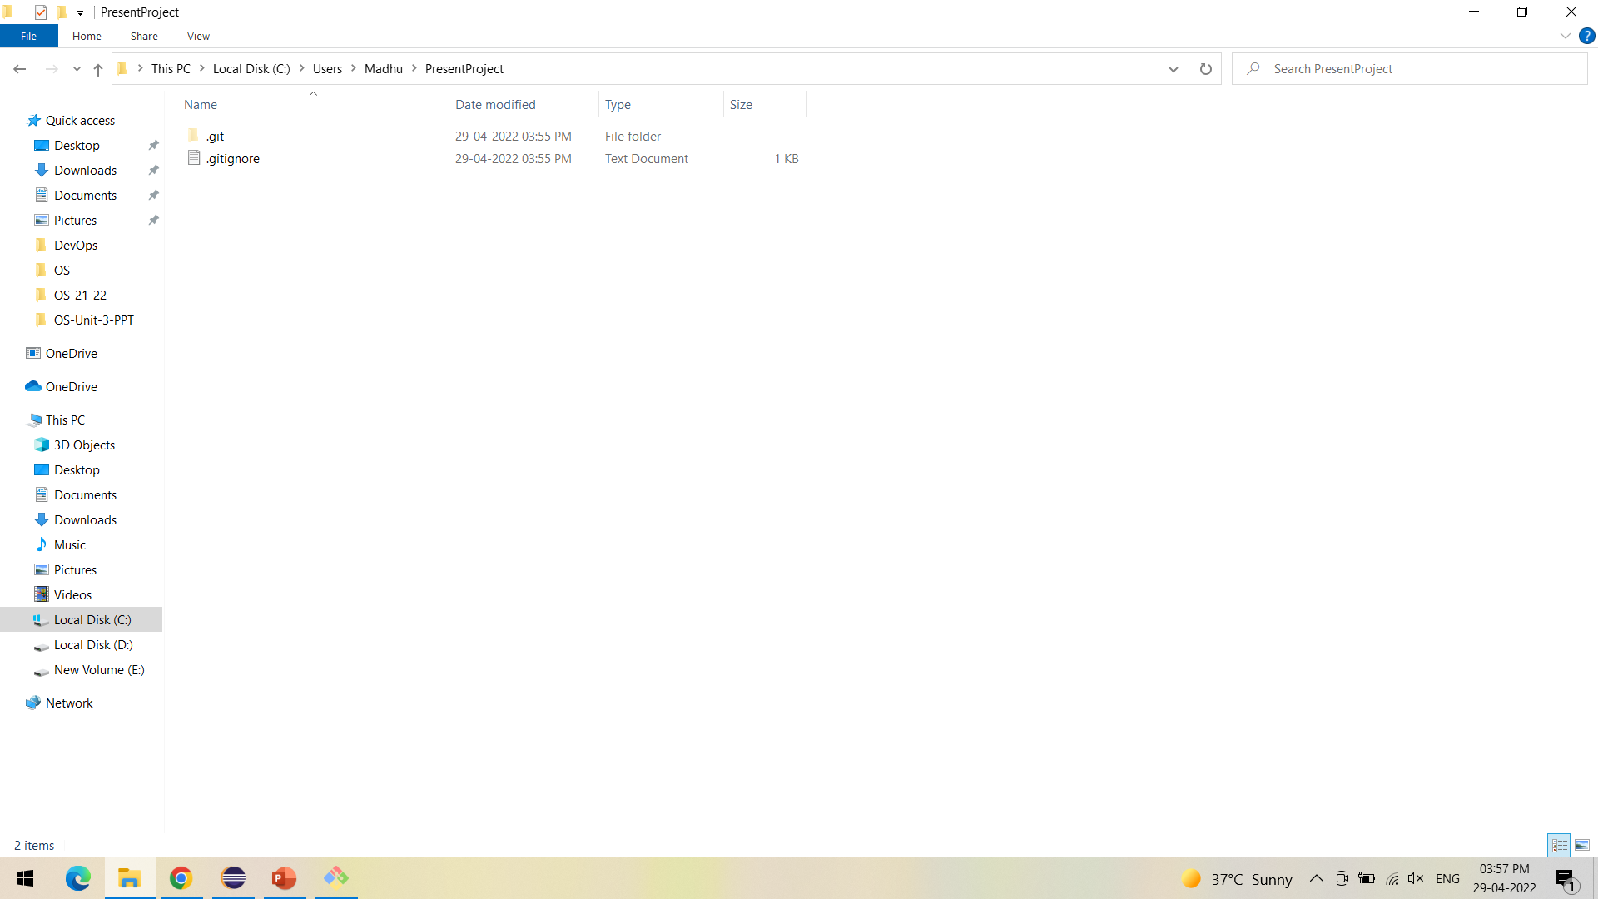
One way of cloning the local and global projects is to copy the contents from eclipse workspace to the local cloned repository as shown

Slide 30
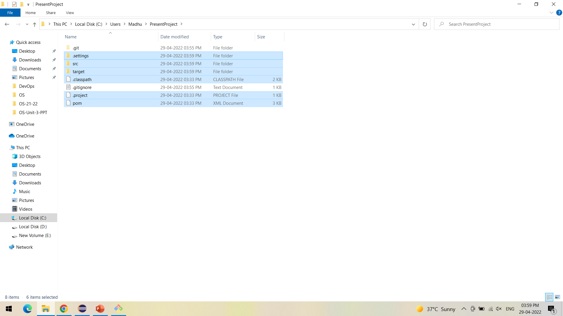
The project files are successfully copied into the PresentProject repository

Slide 31
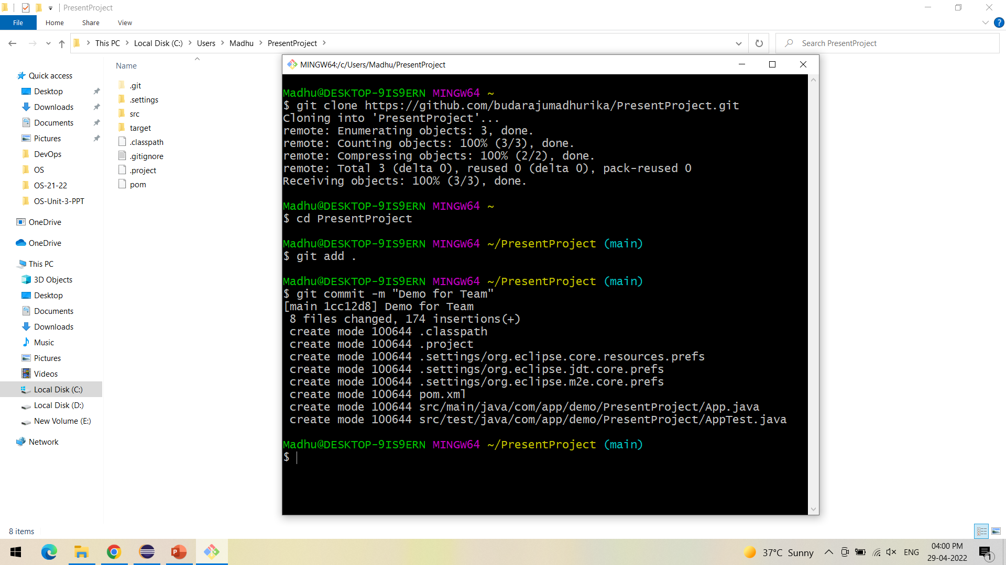
Using Git bash, add and commit the changes made as shown

Slide 32
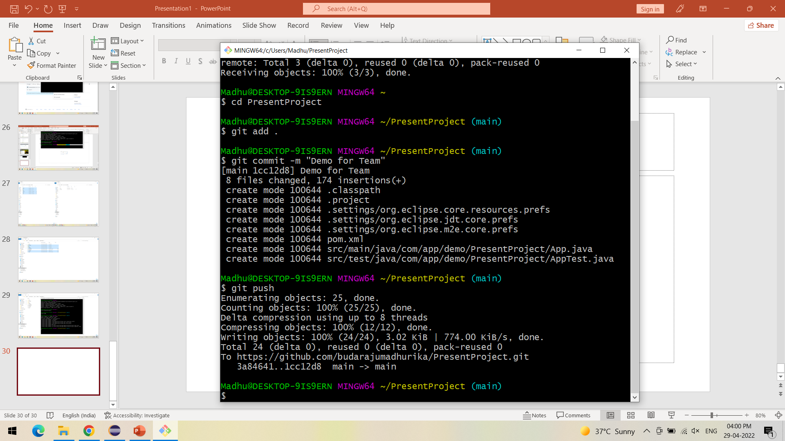
Push the changes to the GitHub as shown

Slide 33
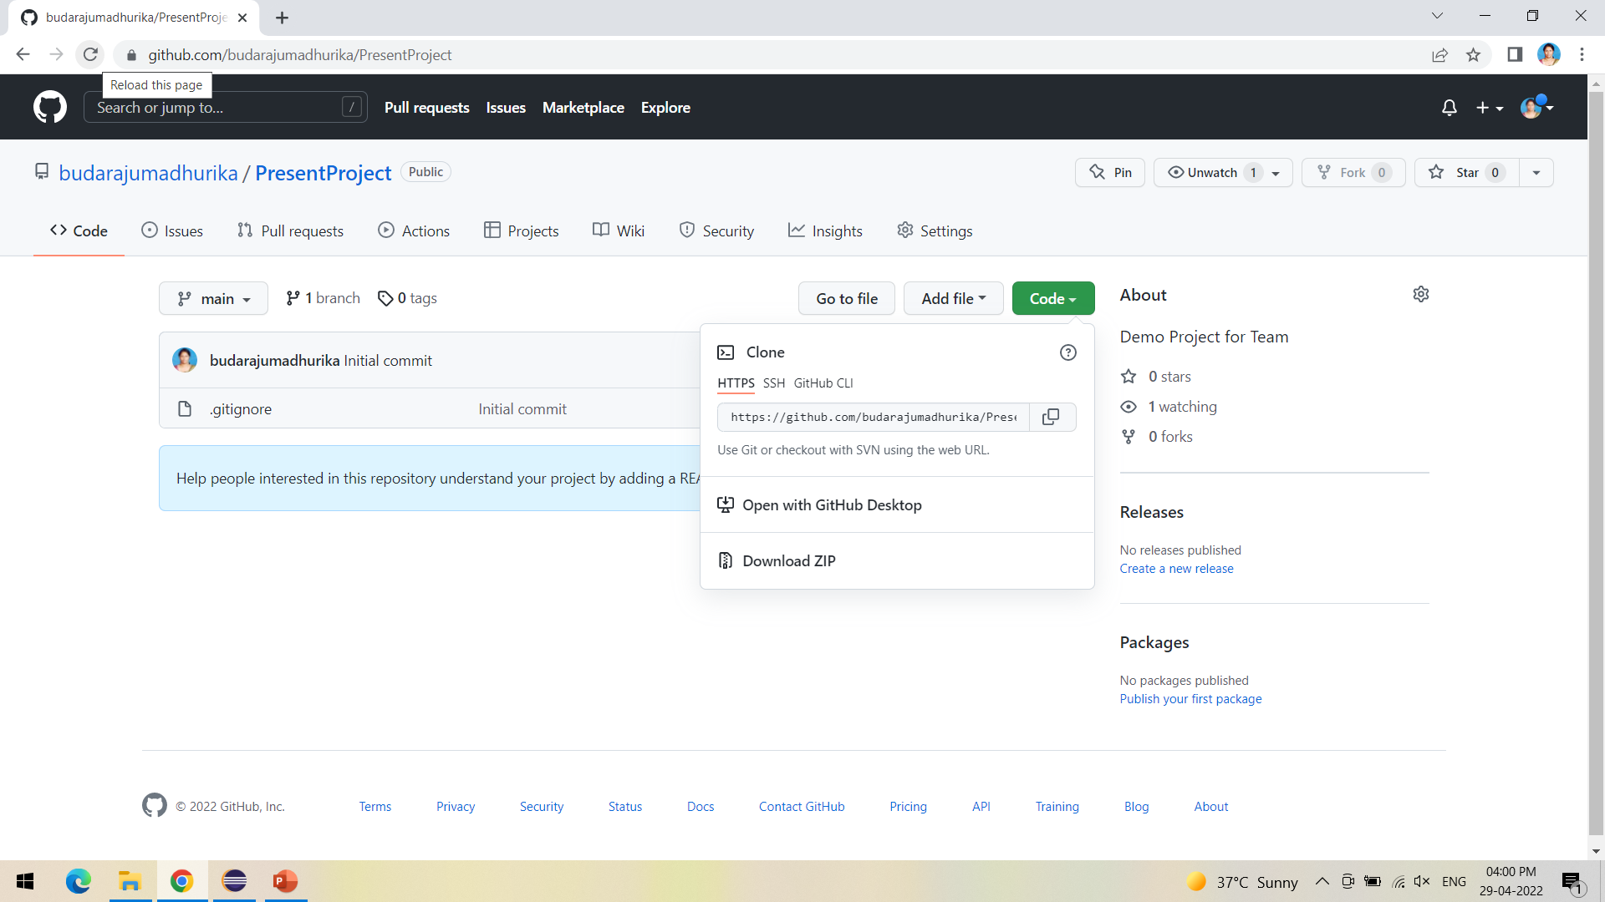
Refresh the GitHub to see the updated repository

Slide 34
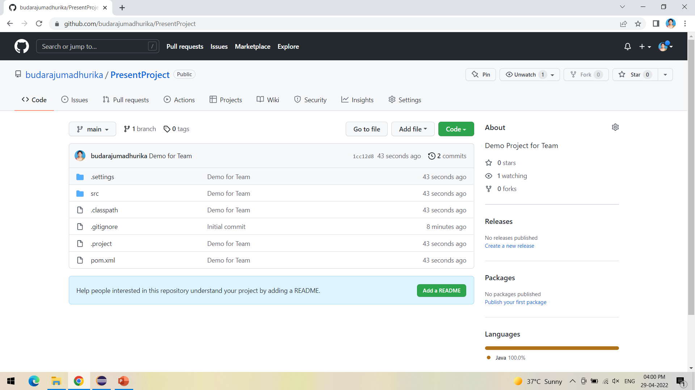
Repository is successfully updated

